Slide 1
SATs Week
13th – 16th May 2024
SATs Information Pack
Notes:
Welcome. An insight into the tests that your children are about to take.

Slide 2
What do SATs tests show?
The idea of the SATS is to show what your child has learned and retained over their time in key stage 2 (years 3 – 6). they are used to help assess your child’s attainment before they transfer to secondary school and allow us to assess the progress made since their SATS at the end of key stage one (year 2).

Slide 3
Can my child fail SATs?
NO!

Slide 4
What do SATs tests show?
The tests will also provide information about how your child is progressing, compared to children the same age nationally. They are not qualifications and don’t affect your child’s future options in school. The results are used to ensure that schools are teaching their pupils the essential knowledge and skills in the subjects that are the early building blocks. This is to ensure every child reaches their full potential.

Slide 5
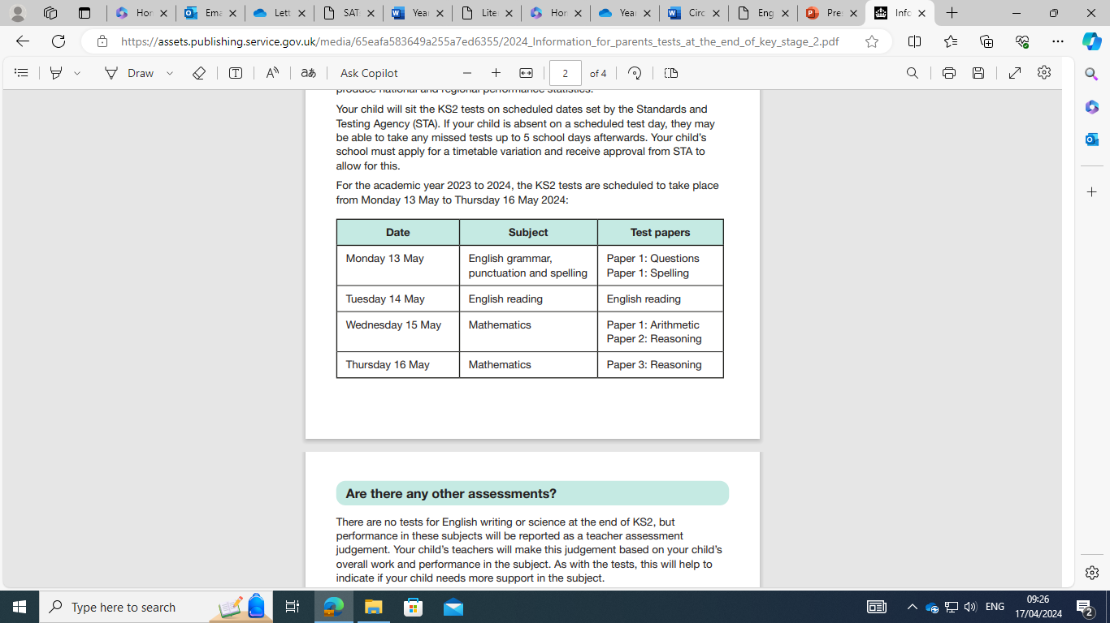
Timetable for the week

Slide 6
What about Writing & Science?
There are no statutory Science tests for our school this year. Science will be assessed through teacher assessment.
Writing is teacher assessed and will be based on the work children have produced throughout the year.
Notes:
Order, timetable

Slide 7
What is Teacher Assessment?
Teachers constantly gather evidence about pupil performance, through talking to and observing your child in class on a daily basis and marking and evaluating their work regularly. This on-going assessment is usually more reliable than formal tests which are a ‘snapshot’ of their achievement. Not all children will achieve their best in the tests, whereas some may excel. Teacher Assessment helps to create a balanced picture.

Slide 8
What about Secondary School?
Although we share the results from the SATs test with the secondary schools, they are actually more interested in our teacher assessments. Most secondary schools undertake their own assessments at the start of Year 7.

Slide 9
The Facts
There are:
3 Maths tests – 1 arithmetic and 2 reasoning
3 English tests (one reading paper an hour long, the punctuation and grammar test, which is 45 minutes and a spelling test.)
The tests are conducted in silence, primarily in classrooms, but also other quiet areas in the school.

Slide 10
Maths
Arithmetic – 30 minutes
Written Papers 1 and 2 (both 40 minutes long).
Few actual discrete calculations –mostly word problems.
No calculators allowed.
Times tables, fractions, division, percentages, area, perimeter, inverse operations, money problems and others!

Slide 11
Arithmetic – example questions

Slide 12
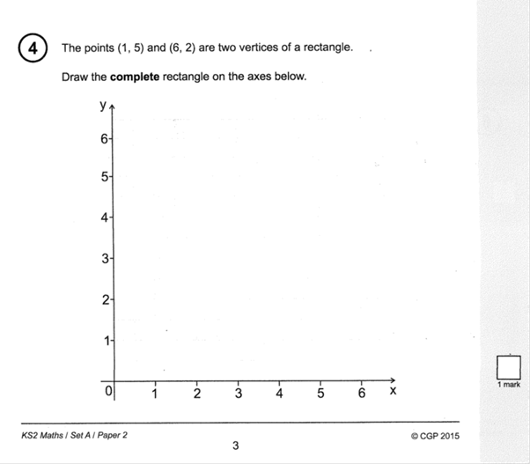
Maths Reasoning – example questions

Slide 13
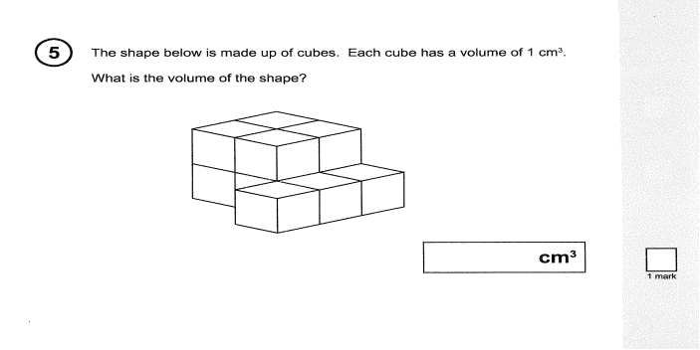

Slide 14
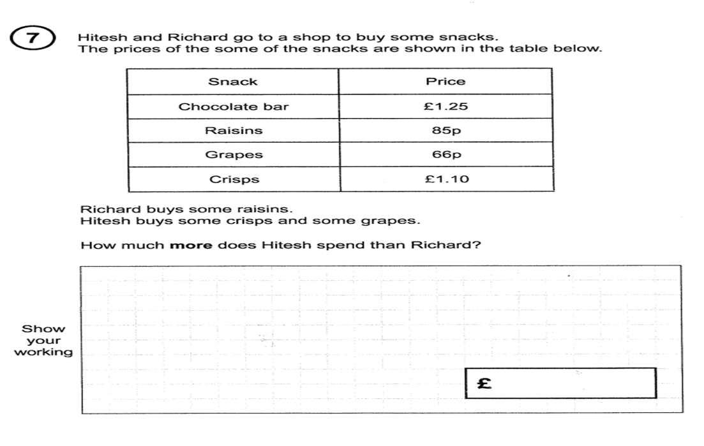

Slide 15
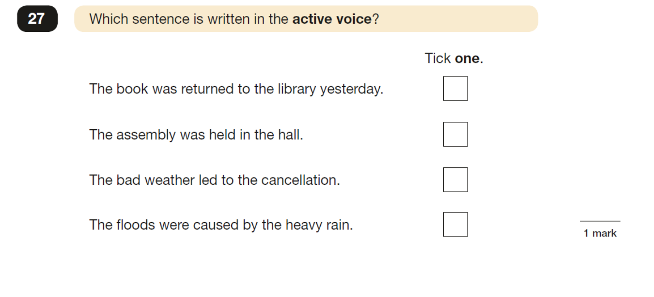
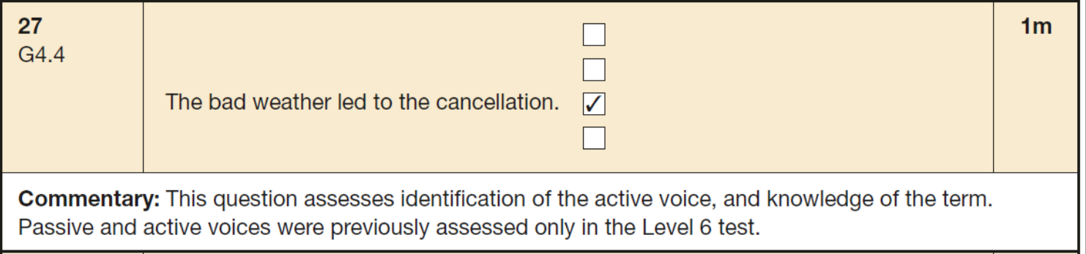
English – grammar and punctuation example questions
Subject does or "acts upon" the verb in such sentences, the sentences are said to be in the active voice. The weather is causing the cancellation.

Slide 16
Command: an authoritative order

Slide 17
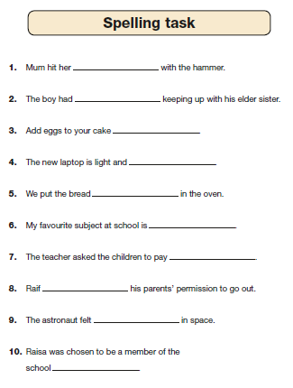
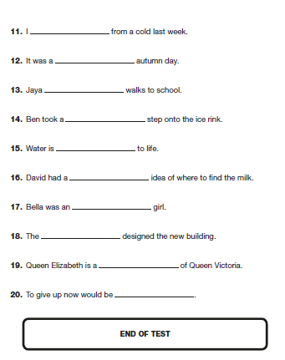
English – spelling test example
The children will be tested on 20 spellings and have to write them in the space provided. Each spelling will be read aloud as part of a sentence.

Slide 18
Reading test
The children have to answer questions on three separate texts (usually one fiction, one non-fiction and one poetry)
Different types of questions
Children are expected to use the text to find evidence (retrieval)
Some questions ask for the children to give their opinions and justify it (inference)

Slide 19
Revision at school
We have been supporting the children in practising the key skills required in all subjects at school.
Booster groups have supported the children in ‘filling gaps’ in their knowledge and having more practise at working on strategies to answer questions.

Slide 20
Who marks these tests?
The test papers will be sealed and sent off to be externally marked.
The results will be sent back to school by early July.
Attainment is defined as end of year outcomes compared to national expectations for pupils in the same National Curriculum year group.
*Please note - teachers will also be submitting a Teacher Assessment for your child which will also be reported to you.

Slide 21
What can you do to help?
Tell them that they are awesome and know so much already!
Ensure that they get a good night’s sleep every day and arrive to school on time.
A good breakfast will help keep their energy levels up.
Talk to them about their tests and reassure them.

Slide 22
Stress busting tips for children
Chill out
If you are starting to lose it, and feel that the studying is getting on top of you - take a bit of time to:
Breathe deeply.
Tell yourself how well you are doing. ☺
Remind yourself that everything is going to turn out alright.
Stand up straight and smile, you will feel a bit better straight away.

Slide 23
Equipment for SATs week
School provides all equipment such as pencils, rulers
Bring your school bag, PE kit and lunch as normal
A “small” mascot
Water bottle

