Slide 1
Welcome to Year 5

Slide 2
Homework
Homework Diaries
Please look at and sign every week
Maths – Set: Wednesday Due in: Monday
Reading – 4 times a week Due: Monday
Spelling – Given at the beginning of Week 1 (Monday) and tested near the end of Week 2 (Friday)

Slide 3
Reading
Look in Homework Diaries for guidance on how to support your child
Children can take books home from school or bring books from home
Reading at home – Year 5 expectation:
4 entries per week
Your child will receive a House Point as a reward for 4 reading entries with ‘Year 5 comments’ and a signed diary, handed in on a Monday morning. It is obviously fantastic if they read more 4 times and this may lead to them becoming the class ‘Reader of the Week’!
Class texts: Floodland, The Promise, Skellig, Cosmic
Please feel free to buy your child a copy of any of the class texts, but DO NOT let them read ahead as this spoils surprises for them. Buying options; second hand or directly from the author’s website.
Please see the front of your child’s homework diary for how to further support your child’s reading at home.

Slide 4
Vocabulary
Comment or idea
Author’s technique
Vocabulary
Connection
Notes:
Project on screen while pupils on task

Slide 5
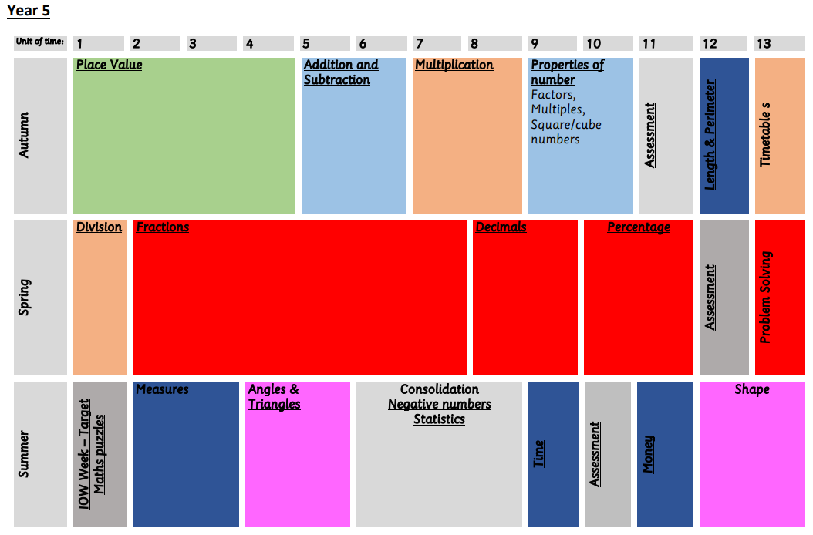
Maths
Please look at the school website: curriculum-maths for how to support your child further at home.
Times Tables: It is very important that children practise their times tables at home as well as at school. We would really appreciate your support with this. Your child has a TTRockstars account provided by the school. This is just ‘one way’ they can practise the Times Tables up to and including 12 x 12.

Slide 6
Spelling
We are working hard to develop your child’s spelling, please support us by:
Helping your child to learn their spellings
Helping them to understand the meaning of the words
Challenging them to think of other words with a similar meaning or spelling pattern
Mastering the Year 5/6 spelling list (see back of homework diaries)

Slide 7
Equipment for School
Pencil case
This needs to be fully equipped; please ask for a list if you are unsure of what they need.
P.E Kit
Mr White insists that the children wear their house colour t-shirt with the school crest. As the weather gets colder, please provide your child with a plain jumper and trousers to keep them warm. No Earrings – please remove on the day of Games/PE.
Uniform
Mr White insists on no jewellery, no nail varnish, no oversized hair accessories and if hair is touching the collar it must be tied back, no trainers or boots.
Always bring a coat to school when it’s cold or likely to rain.
PLEASE NAME EVERYTHING!

Slide 8
Attitudes to Learning
Your children are always being encouraged to develop their attitude to learning in school. These are our learning attitudes:
Risk-taking
Resilience
Persistence
Reflective
Collaborative
Original

Slide 9
What’s coming up in the Autumn Term?
PE: Dance and basketball
RE: Christianity and Islam
Art/DT: Colour wheels, pen and ink, scratch art, printing & sewing
Geog: Rivers
Computing: Networks
Music: Matching a piece of music to a scene from our class text. How can it create a mood?
Christmas performance – No one wraps like an elf.
Dress up day – Climate change
PSHE: Being Me in My World and
Celebrating Difference
Science: Solids, liquids and gases
History: Achievements and legacies in the Greek, Roman and Victorian eras

Slide 10
Isle of Wight

Slide 11
Thank you for your support! We would like to invite you now to come to our classrooms and have a look at all the fantastic work we have done so far this half term! Year 5 Teachers

